Slide 2
detectFASTFeatures(I)
detectFASTFeatures(I, 'MinQuality', 0.5)
detectFASTFeatures(I, 'ROI', [1,1,100,100]);
detectFASTFeatures(I, 'MinContrast', 0.5);

Slide 3
detectFASTFeatures(I)
detectHarrisFeatures(I)
detectMinEigenFeatures(I)

Slide 4
SURF
FAST
BRISK
MSER

Slide 5
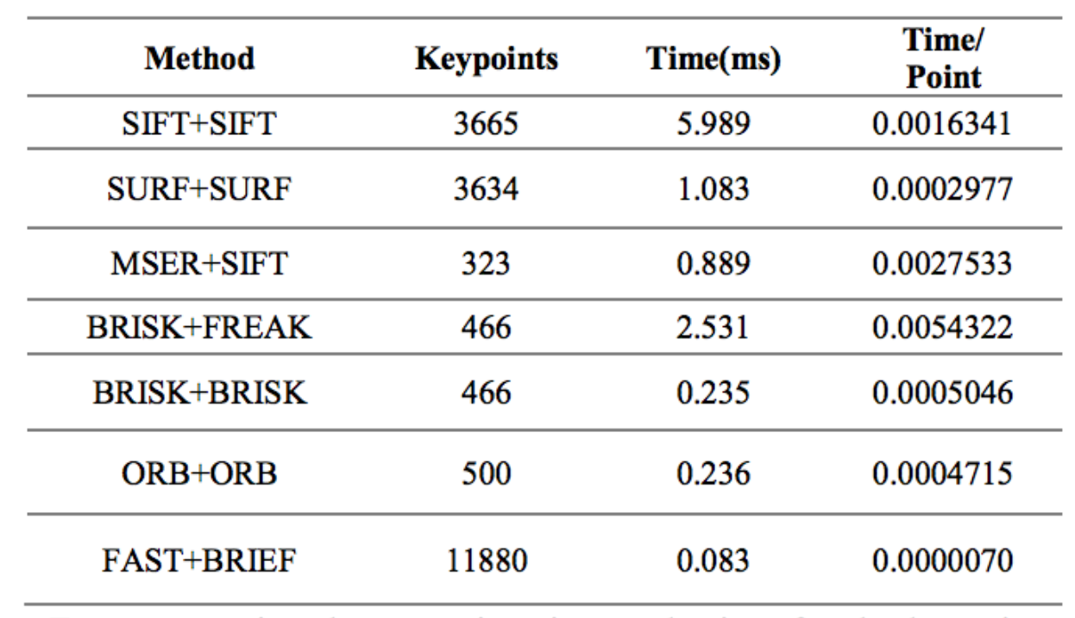

Slide 6
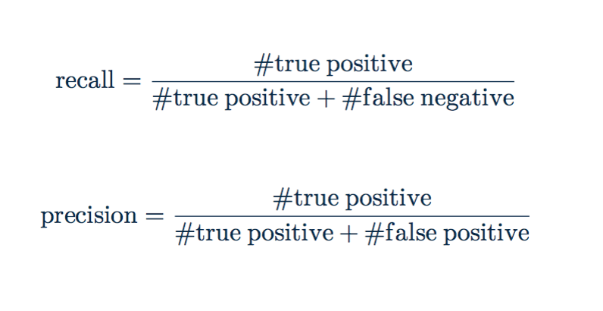
Notes:
the precision refers to the ratio of correct matched descriptors to the number of total positively matched descriptors which are number of keypoints in the reference image that have been matched.

